Slide 1


AI Section 3: Obtaining Data

Slide 2
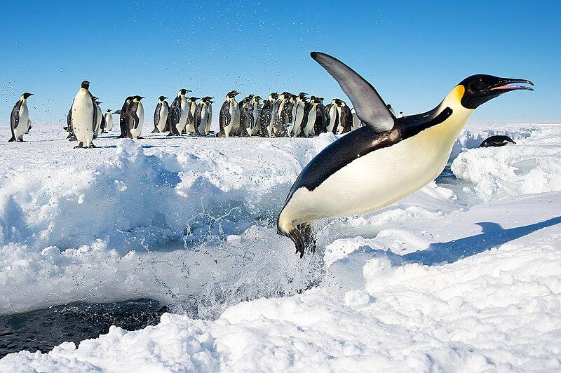
Let’s break the ice!
Do you have any hidden talents?
“Penguin in Antarctica jumping out of the water” by Christopher Michel is licensed under CC BY 2.0

Slide 3
Focus Question
In this unit, you will start to decide what data is important to analyze to see if someone is a new talent.
You will also learn how to pick this data (and not all data) from different websites using a tool called and API.
What are the most important metrics and statistics to collect on someone when deciding if they are new talent?
Think about how talent is defined:
Consistency?
Popularity?
Creativity?

Slide 4
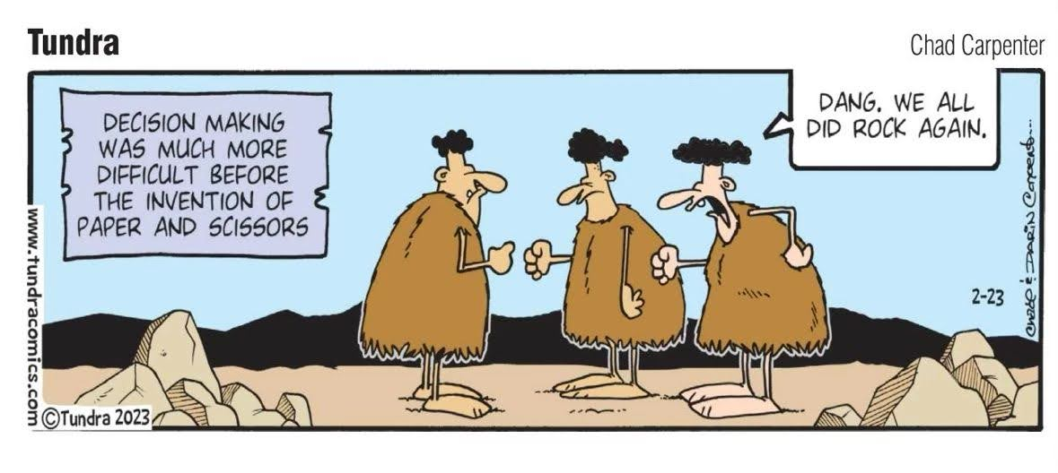
What influences our decisions?
Have you ever tried to decide what new movie to see? How do you decide, what sources of information do you use? What are the most important factors going into your decision to watch a new movie?
Talk with your partner or as a group about what is important in your decision making
“Cartoon--Psychology / history--Decision-making before paper and scissors” by Phil Venditti is licensed under CC BY 2.0

Slide 5
How we obtain data
It is impossible to consider all sources of information when making a decision.
When you think about a movie, the opinion of your friends might be rated higher for you then what a TV station or your parents think about a movie.
Deciding on what data is important in making decisions is what sports or music analysts do.

Slide 6
How we obtain data
In the last module, you looked up some statistics websites for sports or music data and saw there is so much data available.
Even though computers can analyze lots of data, you don't want to waste energy analyzing things that are not important in the decision making.
Today you will look through and decide what data is important. You will focus on either music or sports (but you can do both if you have time) to decide on the factors that are important.

Slide 7


Important Factors - Music
Start with some videos on what people think are important to consider.
Think about what sources of data are suggested here in this video
What factors did this agent look for in signing Dua Lipa. Are these the same factors as the other agent looked for?

Slide 8


Important Factors - Sports
Start with some videos on what people think are important to consider.
What factors did this sports agent suggest as important?
What factors are considered important here?

Slide 9
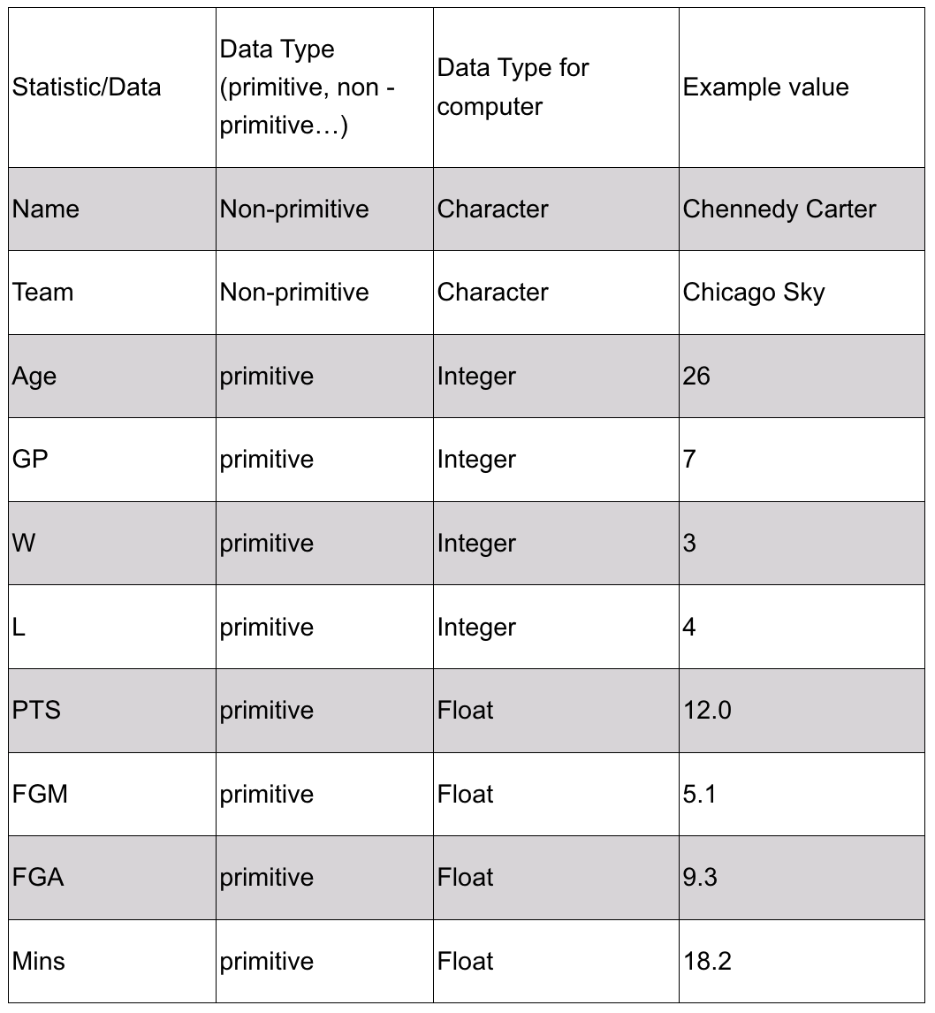
Narrowing down the data
In the last module you looked at data and started writing down some of the information. A snapshot of some data from the WNBA website can be seen on the right.
There was at least 25 metrics on the website, although only a few were recorded here.
How do you know which ones are really important in deciding if a player is really talented or if you wanted to compare a young unsigned player to some current (and highly paid) star?
Ex: Website sports - WNBA

Slide 10
Narrowing down the data
Well, it winds up there are only a few metrics that are really important to define talent in the WNBA.
It winds up that there are only 4 factors that are really important.
There are a lot of websites that describe the four factors that are important in baseball.
Ex: Website sports - WNBA

Slide 11
What is an API and how does it work?
Imagine you want to find out the key metrics information about your favorite music artist on Spotify.
Spotify has a lot of data about different artists, albums, songs, etc. But instead of having to look through all of that data yourself, you can use an API, which is like a special doorway that allows you to request and receive just the specific data you want. It allows your computer program to talk to their database.
Using the Spotify API is kind of like ordering from a menu at a restaurant. The API has different "items" on its menu that represent different kinds of data you can request.
For example, one item might be "Artist Data" and another might be "Album Data."

Slide 12
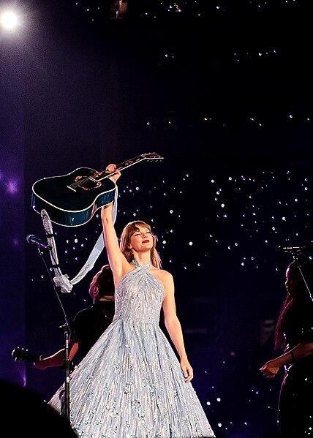
What is an API and how does it work?
So let's say you want to get information about the artist Taylor Swift. You would first select the "Artist Data" item from the API menu.
But the API might need some extra information from you to know exactly which artist you want data for.
So it might ask you to provide the artist's name or a special ID number for Taylor Swift.
“Taylor Swift The Eras Tour Speak Now Set Era (53109976828)
” by Paolo Villanueva is licensed under CC BY 2.0

Slide 13
What is an API and how does it work?
Once you give the API those details, it will go to Spotify's big database and collect all the data it has about that specific artist - things like their bio, popular songs, total number of monthly listeners, and so on.
The API will then send that data back to you in a format that's easier for a computer program to understand and use, like a long list or a special code.
You can then choose which specific parts of that artist data you want to use in your program or application. Maybe you only need their bio and top songs. Or maybe you want to display their monthly listener count.

Slide 14
What is an API and how does it work?
The great thing about APIs is that you can request and get just the data you need without having to comb through Spotify's entire database yourself. It's like having a waiter who brings you exactly what you ordered from the menu!
In order for your computer to talk to the database of another computer, you have to make a "Developer" account. That just means you are someone who has permission to get into the database.
You then get what is known as an "API Key" which is the secret key only you have that lets your computer program enter the database. The key lets the company know who you are, and what data you are collecting from them.

Slide 15
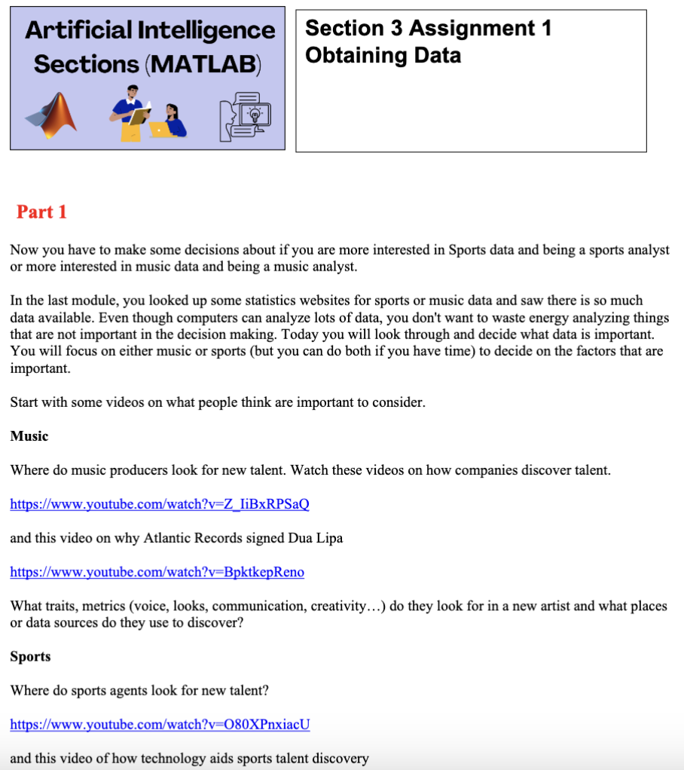
To Do: Practice Obtaining Data
Use this worksheet to help you:
Go to the web. Pick either sports or music and try and narrow it down to a particular sport or music genre. For example, the factors required for a talented soccer forward is different than factors for a midfielder. A country music artist may have different metrics for success than a reggaeton artist. Make sure to make a list of your references.

Slide 16

To Do: Practice Obtaining Data
Once you do this, look for sources of this data for the metrics determined to be important. How would you find out data on "creativity" or "communication skills" how do you think those might be determined. Check to see if the site allows for API access.
“Ray Burnz” by masao nakagami is licensed under CC BY-SA 2.0

Slide 17
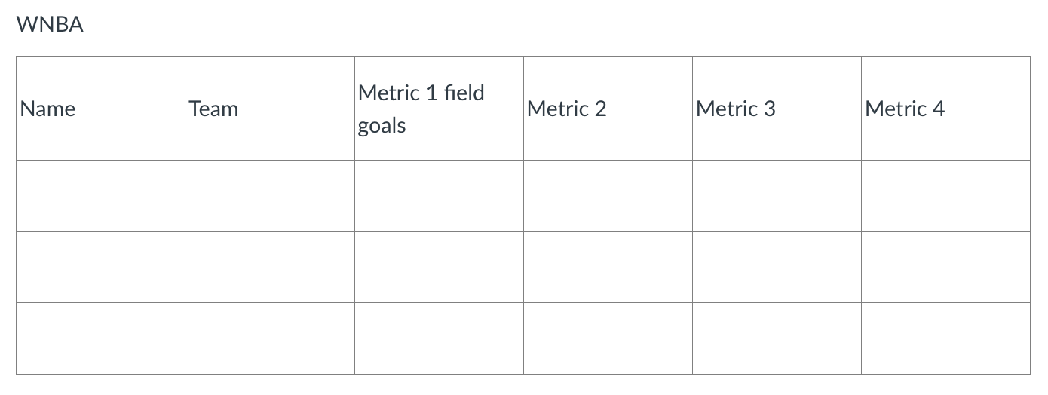
To Do: Practice Obtaining Data
Now that you have sources of data, make a table for that important data and then go look up the information for at least 25 to 30 great artists or players so you have some data you can compare in MATLAB. You can start in Word, and then the table can be pasted into an Excel file.
The table might look like this:

Slide 18
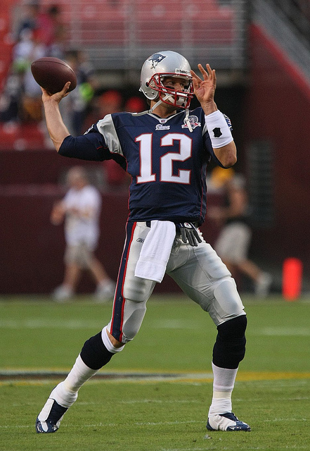
Refine
After you make your list, share it with someone else.
Are they missing any metrics or famous talent that would help define what attributes a new great player should have?
“Tom Brady” by mccarmona23 is licensed under CC BY 2.0

